Slide 1
Linux Kernel Development week 1
工海四 b06501018 朱紹勳

Slide 2
如何使用
Understand Linux Kernel 細節較多，偏向瞭解內核本身
Linux Device Driver 偏向系統程式實作
Linux Kernel Development 趨向兩者之間，編排上也有利於新手
→ 以 Linux Kernel Dev 為主，穿插 Understand Linux Kernel
Focus on OS design discussion – Get Linux 2.6 version source code

Slide 3
Linux Kernel Development Week 1
 | Linux Kernel Dev 3rd | Understand Linux Kernel 3rd | Extra
Intro of Linux & Kernel | Chapter 1 | Chapter 1
Kernel Dev & Programming | Chapter 2 & 6 | Chapter 1 | System Programming Linux Source Code
Interrupt | Chapter 7 | Chapter 4
System Call (optional) | Chapter 5 | Chapter 10

Slide 4
INTRO of LINUX

Slide 5
Chapter 1: Intro of Linux
Multics(failed) → Unix(successful, open source)
Unix characteristic:
Simple enough
Everything is file
C programming language/ a little Assembly
Fast process creation
Virtual memory, file system, LWP, signal, IPC(SVR4), support SMP system
Linux:
Follow POSIX standard (就算內部不同，介面也要保持相同以保障可移植性)
Non-Commercial, open source under GNU

Slide 6
Kernel, not the interface of OS
OS ↔ Kernel
Extended machine (好用, 封裝: user kernel mode) Exception: MS-DOS…
Resource manager
多用戶:安全, UID & User Group ID, root & superuser
Linux is multiprocessing & preemptable system call => mode switch
Kernel mode & Kernel space
Memory, Access Right, Interrupt…
System Call
How user process access kernel service
Interrupt
signal → find specific ISR

Slide 7
Kernel structure:
linux is monolithic kernel
microkernel(not so efficient because communication, but has modulation)
linux provide module, which makes object file link to kernel in runtime
→ better use of RAM, portable in devices, performance…
https://stackoverflow.com/questions/1806585/why-is-linux-called-a-monolithic-kernel
Difference between Linux & Unix Kernel
dynamic loading of kernel modules
preemptive
thread is more like a light weighted process

Slide 8
Kernel
│ ├ General │ ├ Synchronization │ ├ Process Communication │ ├ Process Management │ ├ Memory Management │ └ Device Driver
File System

Slide 9
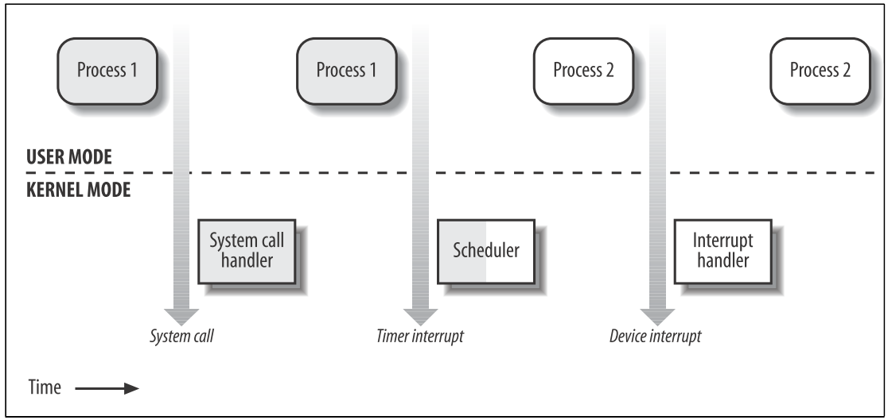
Kernel Overview
Process/ kernel mode
Kernel is a process manager, which exists all the time
kernel thread is a privileged process run in Kernel Mode and Space
(1) System call (2) CPU exception (3) External Interrupt (4) Kernel thread may activate kernel mode
Process
Descriptor will store info of processes from registers
PC, Stack Pointer Reg, Processor Control Reg, Memory Management Reg
Want to resume process: Register → Descriptor

Slide 10
Reentrant(可重進) Kernels
Kernel thread 可以釋放CPU， 由此避免阻止其他想進入Kernel 的 process
Allow multiple processes run in Kernel Mode
Process Address Space
While entering Kernel → access Kernel data, code area, private stack
Linux support mmap() system call

Slide 11
Kernel Overview - Synchronization
Reentrant Kernel → Multi-Process → Race Condition → Synchronization
Non-preemptive(Unix), disable Interrupt is not efficient
Linux use:
Semaphores
An interger, waiting process list, down()&up() (atomic)
Integer < 0, cannot access
Spin lock
Only Use in multi-processor

Slide 12
Kernel Overview - Process Communication
Shared memory / Message Passing
POSIX has 20 signals, with following responses:
1. Ignore 2. Terminate 3. Core dump 4. Suspend 5. Resume
System Calls…
shmget(key, size, shmflg) // create share memory
semget(key, size, semflg) //
msgget(key, msgflg) //
msgsnd(), msgget() // put and get from message queue
All the resource has to release manually

Slide 13
Kernel Overview - Process Management
fork() / exit() / exec()
fork() has “Copy-On-Write” mechanism
exit() use system call to terminate process, and signal “SIGCHILD”
Zombie Process
waitpid() (wait4())
Avoid zombie process → init is the parent of all zombie

Slide 14
Kernel Overview - Memory Management
Virtual Memory
MMU : Map memory address from virtual to physical
Relocatable, large memory requirement, exec partly loaded program
RAM
1. kernel image 2. virtual memory system
Page–frame reclaim algorithm
Handle process virtual addr space
Caching
First check if the data is already in RAM
sync() sys call : make RAM and disk data consistent

Slide 15
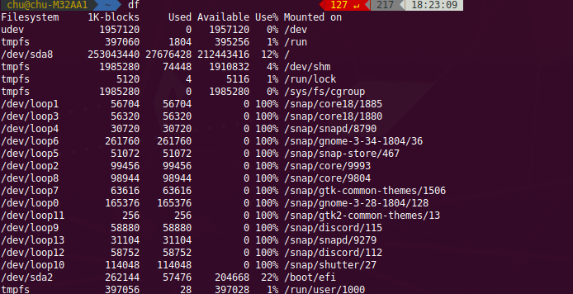
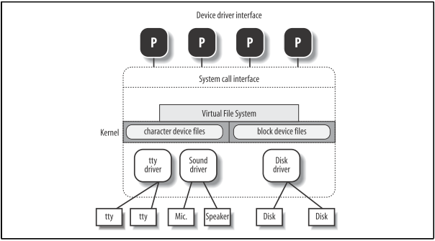
Kernel Overview - Device Driver
Device-specific code is encapsulated in modules
Develop new compatible device by only knowledge interface spec
Reduce Kernel Image in RAM

Slide 16
I. Linux Basic Concept File System(1)
Linux File system:
in tree-structured namespace, file name < 255 characters
pathname
absolute (/usr/fold/file), relative(usr/fold/file)
current directory(./), parent directory(../)
Link
File system is a hard link
Hard Link ($ ln P1 P2)
→ May cause directory tree to cycle… Harmful
→ Can only link when files are in same file system… Limited
soft link or symbolic link ($ ln -s P1 P2)
To overcome the short of hard link
File type
Regular file, Directory, Symbolic link, pipeline, socket...File type

Slide 17
File description (POSIX Standard)
File type, # hard link, file length, UID, UGID, Access right, time…
suid(set user ID), sgid(set group ID), sticky(keep file in memory after terminated)
File Handling system call: (system programming course)
fd = open(path, flag, mode); // flag: operation, mode: access right
Ext2 & Ext3, jfs
Block, Superblock, Inode
file recover
Journal File System
Notes:
第二延伸檔案系統
Block (區塊)： 檔案在磁碟中被儲存在整數固定大小的區塊中， 那區塊的大小通常是2的次方。在預設中，ext2檔案系統的區塊大小是4K。研究顥示， 4K位元組對於一磁碟區塊而言是最理想的大小，假如一個檔案的大小無法達成4K位元組的倍數時， 那最後的磁碟區塊部分就會被浪費。在最不好的例子中幾乎在完整的區塊中就有一位元組被浪費掉。 對於這情況有一點技巧，假如我們選擇了一個較大的區塊，則對於小的檔案而言會有一些磁碟空間被浪費掉。 另外一方面，假如我們使用一個非常小的區塊，則磁碟區塊數量會成指數的增加， 因此對於檔案而言需有更多的搜尋時間。所以，選擇區塊大小必須三思而後行。 當一個檔案被載入到記憶體時，那磁碟區塊會被放在主記憶體中之緩衝快取區，假如它們已經變更了， 區塊在緩衝區中會被標記為’Dirty’， 其意指的是這些區塊必須先寫到磁碟中來維持磁碟上的區塊及在主記憶體中的區塊之一致性．
Superblock：superblock 是在每個檔案系統開始的位置， 其儲存資訊像是檔案系統的大小，空的和填滿的區塊，它們各自的總數和其他諸如此類的資料。 要從一個檔案系統中存取任何檔案皆須經過檔案系統中之superblock。如果superblock損壞了， 它可能無法從磁碟中去取得資料。
Inode: 對於檔案系統而言一個inode是在inode表格中的一個項目。 Inode包含了所有檔案有關的資訊例如名稱、大小、連接的數量、資料建立之日期，修改及存取的時間。 它也包含了磁碟區塊的檔案指向(pointer)。pointer是用來記錄檔案被儲存在何處。

Slide 18
Chapter 2: Linux Kernel Dev
/arch
OS design is heavily dependent on hardware arm, i386, ia64, mips,x86_64…
/driver
/firmware
/ipc
/usr
/kernel
/script

Slide 19
Chapter 2: Linux Kernel Compile The Kernel
Kernel Development:
coded in GNU C (no linked to the standard C lib!!!)
NO memory protection
avoid float computing
small stack
watch out for the synchronization problem

Slide 20
System Programming & Data structure

Slide 21
System Programming
man –f prinft
man 2 (system calls) man 3 (library calls)
gcc (compiler)
gcc abc.c // must contain main func, abc.out
gcc abc.c –O3 // 1, 2, 3, g, fast, s
gdb (officical debugger)
b: breakpoint, bt: current call stack, s: step in, n: step over, r: execute
Make
Notes:
編譯器.o通過編譯源代碼來生成目標文件，然後將源代碼與平台的目標文件和庫進行鏈接，以生成該.out平台的可執行目標文件，這一過程稱為鏈接。

Slide 22
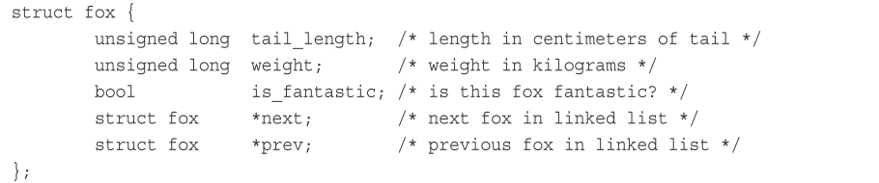
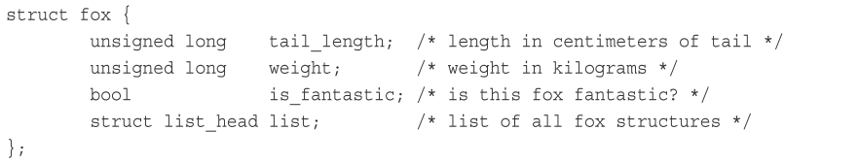
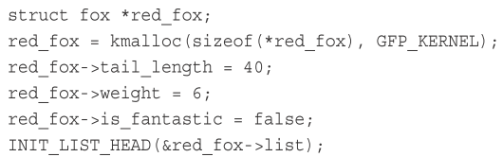
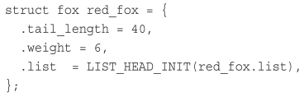
Data Structure
C is not O-O language (use struct)
Linked List: General C form Doubly-LL (handcraft) Linux Development Doubly-LL, use <linux/list.h>

Slide 23
ADD ITEM: list_add(&f->list, &fox_list); list_add_tail(&f->list, &fox_list); DELETE ITEM: unsigned int kfifo_in(struct kfifo *fifo, const void *from, unsigned int len); unsigned int kfifo_out(struct kfifo *fifo, void *to, unsigned int len); CONCATE EXISTING LIST: list_move(struct list_head *list, struct list_head *head) list_move_tail(struct list_head *list, struct list_head *head) TRAVERSE OVER LIST: list_for_each_entry(f, &fox_list, list) {
/* on each iteration, ‘f’ points to the next fox structure ... */
} list_for_each_entry_reverse(pos, head, member)

Slide 24
Queue
FIFO structure, <linux/kfifo.h>
CREATE: int kfifo_alloc(struct kfifo *fifo, unsigned int size, gfp_t gfp_mask); // return 0 when success ENQUEUE, DEQUEUE: unsigned int kfifo_in(struct kfifo *fifo, const void *from, unsigned int len); unsigned int kfifo_out(struct kfifo *fifo, void *to, unsigned int len); GET SIZE OF QUEUE: static inline unsigned int kfifo_size(struct kfifo *fifo); static inline unsigned int kfifo_avail(struct kfifo *fifo); RESET, & DESTORY: static inline void kfifo_reset(struct kfifo *fifo); void kfifo_free(struct kfifo *fifo);

Slide 25
Maps
Asscociative array, key-value pair, often use for UID
Data structure: hash table, self-balanced tree
INITIALIZE idr: void idr_init(struct idr *idp); ALLOCATE NEW UID: int idr_pre_get(struct idr *idp, gfp_t gfp_mask); int idr_get_new(struct idr *idp, void *ptr, int *id); FIND UID: void *idr_find(struct idr *idp, int id); GET SIZE OF QUEUE: void idr_remove(struct idr *idp, int id); RESET, & DESTORY: void idr_destroy(struct idr *idp); void idr_remove_all(struct idr *idp);

Slide 26
BST & self-balanced
Red-Black Trees <linux/rbtree.h>
Data Structure:
Traverse : linked list (O(n)) Producer Consumer Pattern: queue Map UID : map Data Storage & Access: RBTree

Slide 27
Interrupt

Slide 28
Interrupt
Synchronous vs. Asynchronous → Exceptions(1. error 2. int/sysenter) vs. hardware I/O
Interrupt ReQuest (IRQ)
When receive an Interrupt signal: 1. CPU halt, save Reg → Kernel Mode Stack 2. Put address to PC
Context switch vs Interrupt

Slide 29
Interrupt vs. Exception
Interrupt:
Maskable (可屏蔽) : Gerneral Nonmaskable (不可屏蔽): Emergency, ex: hardware failure
Exception - processor detected error Fault : error addr → eip, fault can be fixed and resume Trap : next exec addr → eip, usually for debug Abort : Fatal Error, no info in eip, Programmed Exception: by int or int 3, also called software interrupt
Use 0-255 to identify Interrupt or Exception

Slide 30
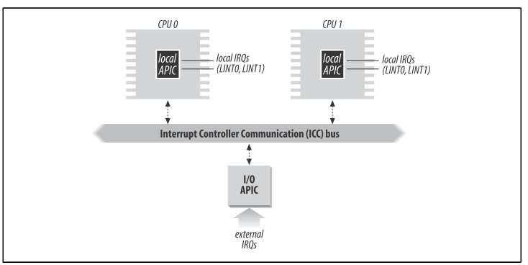
Interrupt - IRQ, PIC & APIC
Programmable Interrupt Controller
Monitors IRQ line and wait for signals. If YES:
a. Signal → vector → Interrupt Controller(CPU read Vector via the data bus)
b. Signal to the processor INTR pin
c. CPU write signal to Programmable Interrupt Controllers (PIC), clear INTR
IRQ line can be enable/disable by PIC, total 2 “8259A” & 15 lines.
For Multi-Processor, use A (advance) PIC
APIC I/O, Interrupt Control Comm bus

Slide 31
Exception
80x86 has 20 exceptions →hardware error code → Kernel Mode Stack
Div 0 Debug Overflow Device not available…

Slide 32
Interrrupt - Interrupt Descriptor Table
Associated with interrupt (exception) vector with address
Total 2048 bytes (256*8 byte each table)
Contain 3 types of Gate Descriptor:
Task Gate Descriptor : TSS selector of process to replace interrupted ones
Interrupt Gate Descriptor : Handle Interrupt
Trap Gate Descriptor : Handle Exception

Slide 33
Interrrupt - IDT – Hardware Handle
Detailed description in <Understanding Linux Kernel>
Contain:
1. Initialize Table
2. Different operation under Interrupt & Exception, and others
2.1 Exception
2.2 Interrupt
2.3 Softirqs & Tasklets
2.4 Work Queue
3. Return from Interrupt & Exception

Slide 34

Interrrupt - IDT - Exception
Register → Exception Handler
Assembly code
push address to stack using do_xxx()
Enter Exception Handler
exec do_xxx()
Exit from Exception Handler
keep tracking signals (user/kernel)
ret_from_exception()

Slide 35
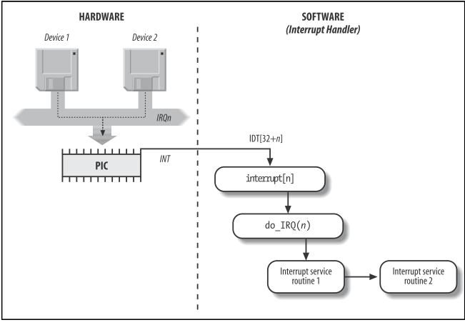
Interrrupt - IDT - Interrupt
Types: (1) I/O, (2) Timer, (3) Interprocess
Save IRQ and register value in Kernel Stack
Sending signal to corresponding PIC for futher interrupt
exec ISR do_IRQ()
Exit from interrupt ret_from_intr()

Slide 36
Interrupt Service Routine
ISR is normal C function, but run in interrupt context
Interrupt context is not like Process context, the former cannot sleep
Interrupt context interrupt other code, so should be quick and simple
The context is divided in to Top and Bottom section, which reduce work load
It share the stack with process that interrupted
Registering an Interrupt Handler
Use request_irq(irq, handler, flag, name, dev) (<linux/interrupt.h>) // return 0 if success irq : Interrupt number for hardware, or defined
handler : point to actual interrupt handle program
flag : IRQF_DISABLED, IRQF_SAMPLE_RANDOM, IRQF_TIMER, IRQF_SHARED
name : defined in /proc/interrupts file, interrupt line, counter, device name…
dev : Use for shared interrupt lines, set NULL if not

Slide 37
Interrupt Service Routine
Freeing an Interrupt Handler void free_irq(unsigned int irq, void *dev)
Writing an Interrupt Handler
static irqreturn_t intr_handler(int irq, void *dev)
// corresponded with request_irq()
Shared handler
1. Set flag = IRQT_SHARED in request_irq() (old version) 2. Must define parameter dev 3. Hardware support

Slide 38
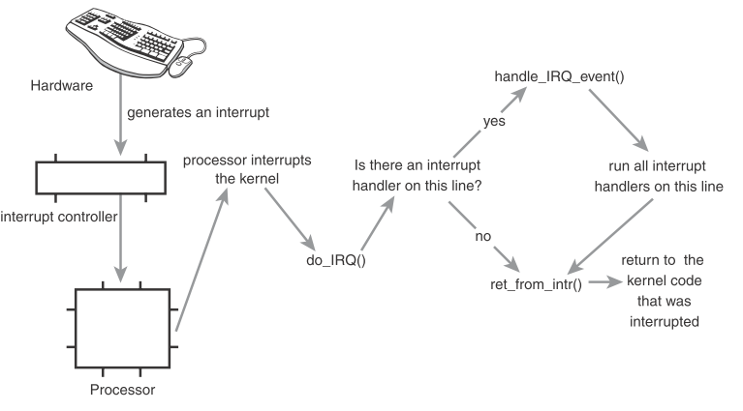
IRQ
unsigned int do_IRQ(struct pt_regs regs)
After calculate the interrupt number and
disable others
do_IRQ → handle_IRQ_event()(kernel/irq/handler.c) → ISR
arch/x86/kernel/entry_64.S
arch/x86/kernel/irq.c

Slide 39
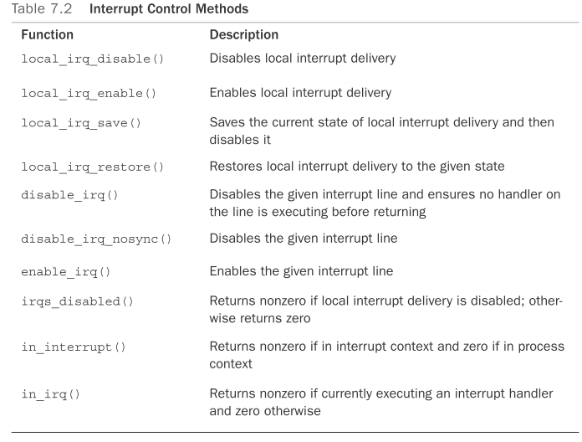
Interrupt Control
<asm/system.h> <asm/irq.h>
The need for synchronization → guarantee that an interrupt handler will not preempt your current code, even disable interrupt by kernel

Slide 40
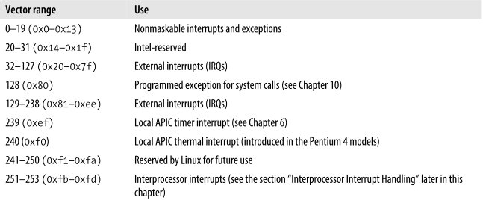
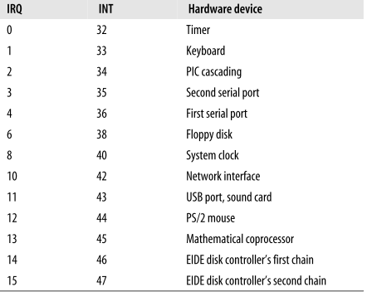


Slide 41
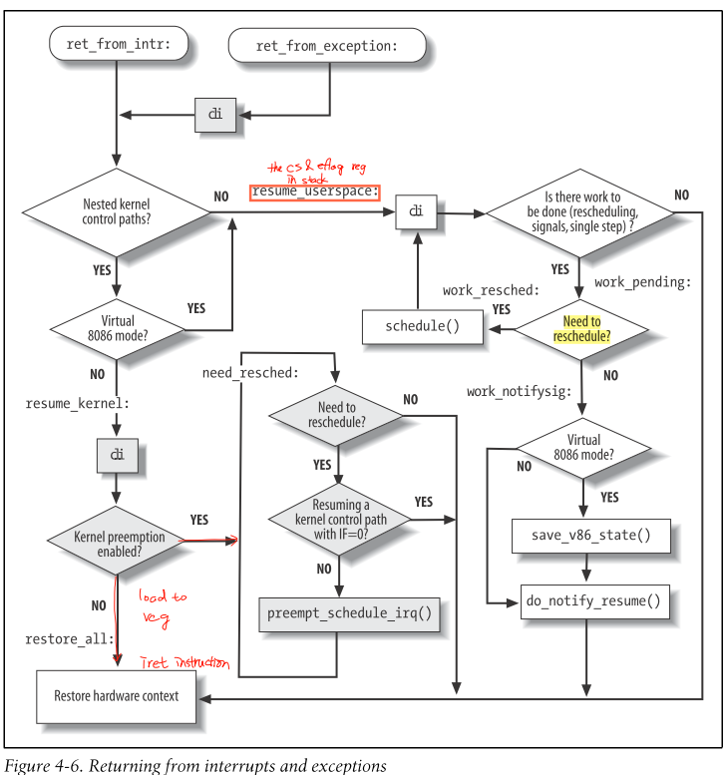
Exit from interrupt
Consideration:
Number of kernel control paths
Pending process switch requests
Pending signals
Single-step mode
Virtual-8086 mode

Slide 42
Interrrupt - IDT - Softirqs & Tasklets
Not urgent interrupt, softirqs(static), tasklet(dynamic, runtime)

Slide 43
Interrrupt - IDT – Work queue
Similar to deferrable function, but…
Deferrable run in interrupt context, work queue run in process context

Slide 44
System Call

Slide 45
System Call
A layer between user process and hardware
Make programming easier (API) - POSIX
improve system security : Access Right, Encapsulation
Other ways to enter Kernel : exception, external interrupt
API vs. Sys Call → A function definition / A request to kernel by trap trap : the software interrupt defined #interrupt 128 in X86
Trigger by int $0x80 instruction
Return of Sys Call:
usually (-) means error
or defined in errno.h ex : include/asm-i386/errno.h

Slide 46
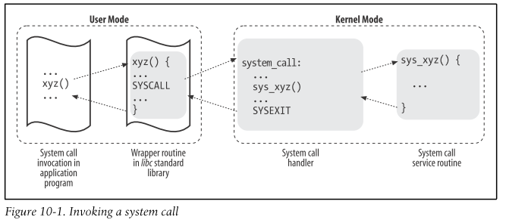
System Call - Handler & Service Routine
Routine
Save register to Kernel Mode Stack
→ C func() → System call handler(assembly) → System Call Service Routine
Exit from handler, Stack → register, Switch to User Mode
System Call Identification
We will pass system call number to help us, EAX register → Kernel
find #system call in dispatch table(store in an array), there are 289 in 2.6 ver
NR_syscalls macro 檢查 system call 是否合法
if so, call *sys_call_table(,%rax,8);
Parameter of func() : ebx, ecx, edx, esi, edi register in X86_32
Name of Service Routine : sys_xyz() ← xyz()

Slide 47
System Call - Ways to invoke Sys Call
There are two ways to invoke and exit Sys Call:
invoke : 用 int $0x80 assembly (old) exit : 用 iret assembly (old)
invoke : 用 sysenter assembly
exit : 用 sysexit assembly
The following are the descriptions:

